Slide 1



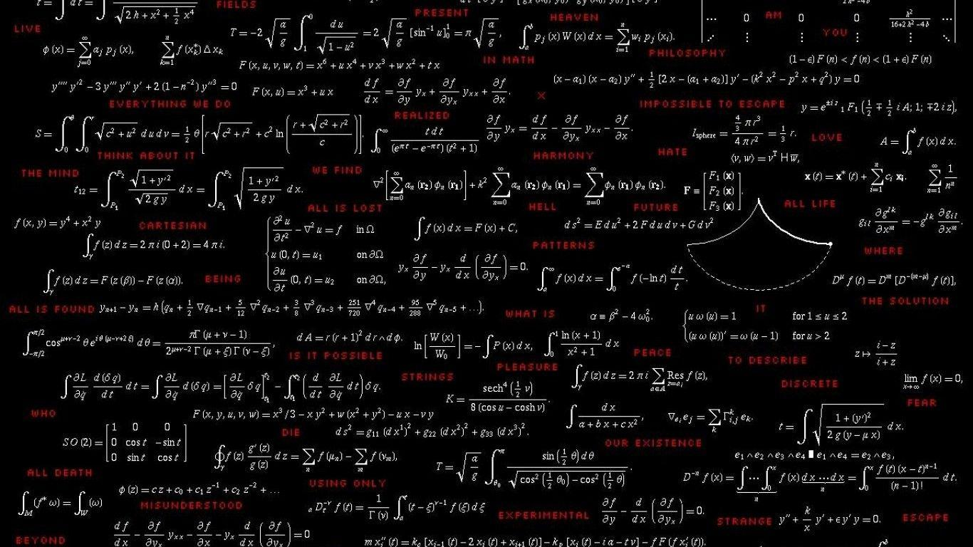
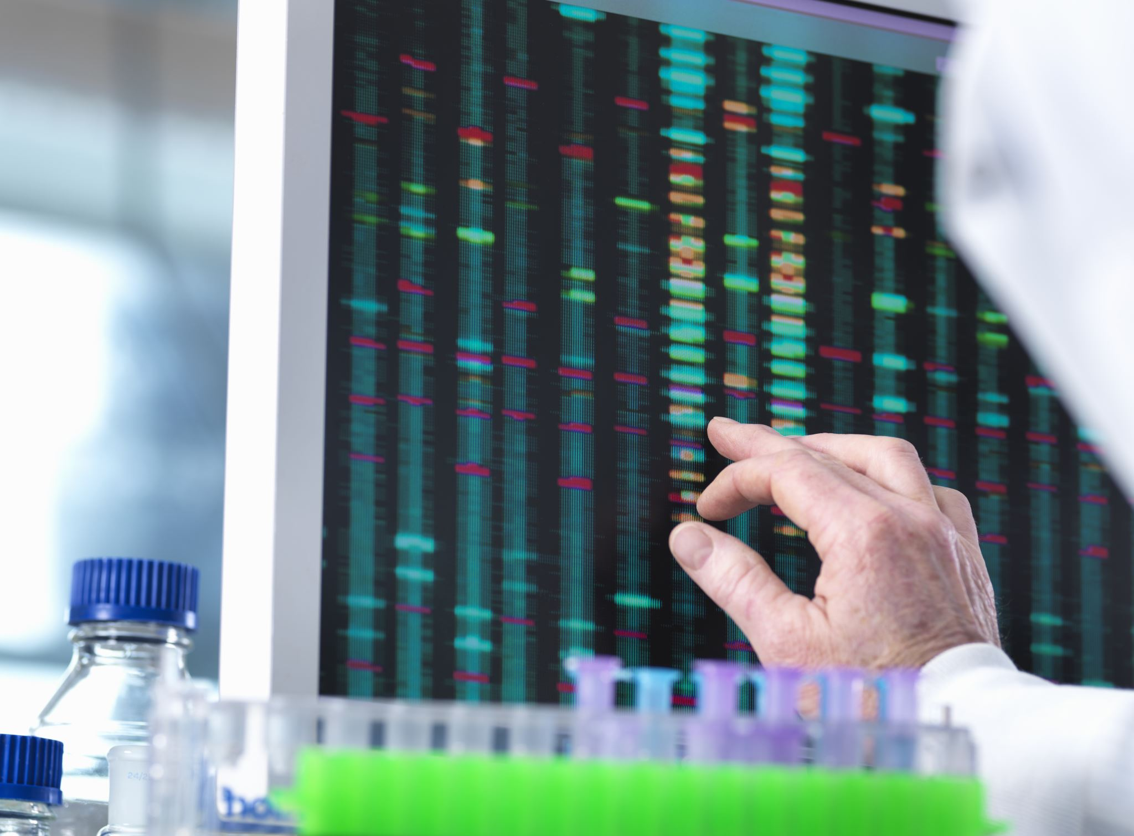
Calculus And Analytical Geometry in Everyday Life and CyberSecurity
Presented by:
Haani Bin Qaiser Asim Saleem M. Abaid
M. Rizwan
Nayab Farooq
Umaria Kanwal
Kshaf Asjad
Zakia Qayyum
BSCYS-F24B | Air University

Slide 2

Introduction
Mathematics is deeply integrated into our everyday life and technological systems. Calculus and analytical geometry allow us to model real-world problems mathematically and find efficient solutions. From predicting motion to securing computer networks, these branches of mathematics are widely used in science, engineering, computer science, artificial intelligence, and cyber security.

Slide 3


Calculus
Definition
Studies continuous change
Explains motion, growth, and optimization
Used in science, engineering, and computing
Calculus helps us understand how one quantity changes with respect to another, such as speed changing over time.
Branches
Calculus is divided into two major branches:
Differential Calculus: Rate of Change of Functions
Integral Calculus: Deals with Accumulation

Slide 4




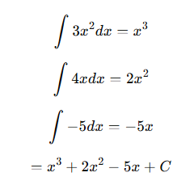

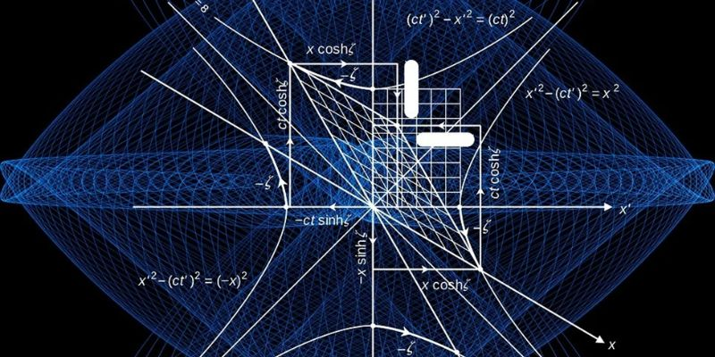
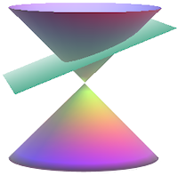
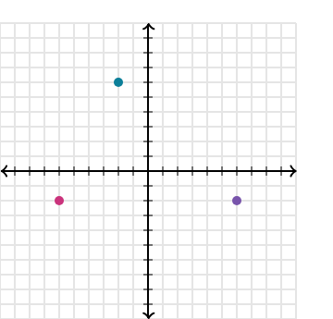
Examples
Derivation
Integration

Slide 5
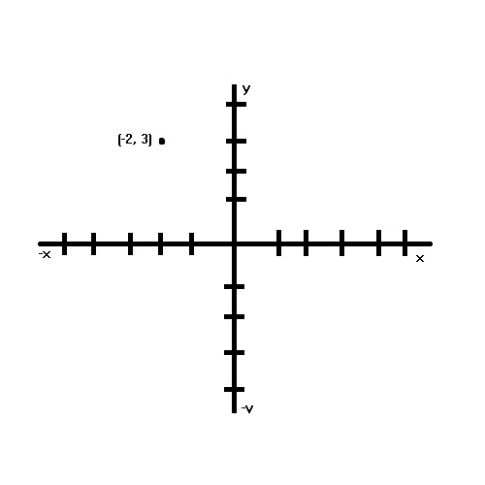
Analytical Geometry
Definition
Analytical geometry connects algebra with geometry by representing shapes using equations.
Uses coordinates and graphs
Helps study lines, curves, and circles
Widely used in design and navigation
Coordinate System
The coordinate system consists of two perpendicular axes called the X-axis and Y-axis. Every point on a plane is represented by an ordered pair (x, y). This system is the basis of graph plotting, digital mapping, and screen display systems.
Example: Point (−2, 3) is located by moving 2 units left and 3 units upward.

Slide 6
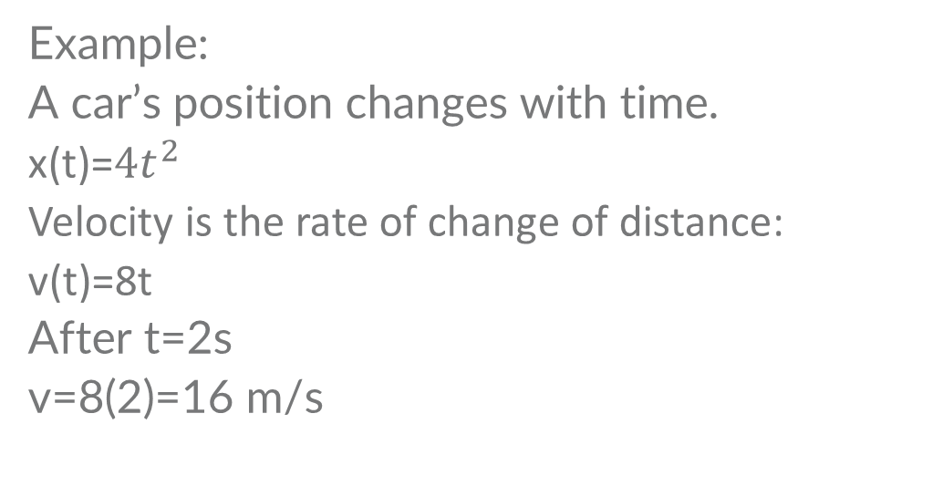
Calculus in Daily Life
Example
Example:
A car’s position changes with time.
x(t)=$4t^{2}$
Velocity is the rate of change of distance:
v(t)=8t
After t=2s
v=8(2)=16 m/s
01
Calculus appears in many daily activities where change occurs.
Speed and acceleration of vehicles
Weather forecasting models
Medical signal analysis
02

Slide 7

Calculus In Technology
Modern technology relies heavily on calculus for optimization and prediction. Signal processing, image enhancement, and system control all use derivatives and integrals. Calculus ensures efficient use of resources in engineering and computing systems.

Slide 8

Calculus In Technology
Example:
A system’s processing cost (time, power, or resources) depends on some variable 𝑥.
The cost function is:
$$\text{C}\text{(}\text{x}\text{)= }\text{x}\text{^2 − 8}\text{x} \text{+} \text{20}$$
For minimum value of cost, let C’(x) = 0
C’(x) = 2x – 8 = 0
x = 4
When $x=4$, the system’s processing cost is minimum

Slide 9
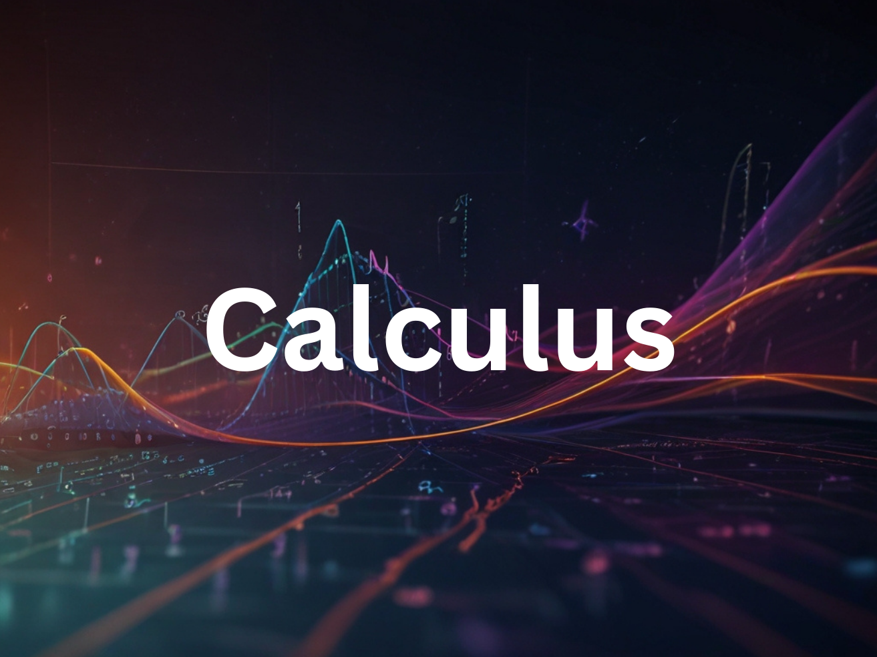

Algorithm Time Complexity
Applications in Computer Science
Time complexity tells us how fast or slow an algorithm runs as input size increases. It is expressed using mathematical functions such as linear, quadratic, or logarithmic functions.
For Example:
Given Algorithm Time Function:
$$f\left(n\right)=n^{2}+3n$$
Find Time when,
n = 5
Then, $f\left(5\right)=5^{2}+3\left(5\right)=40$
Conclusion: When the input size is 5, the number of operations will be 40, which shows quadratic growth, meaning time increases rapidly.

Slide 10
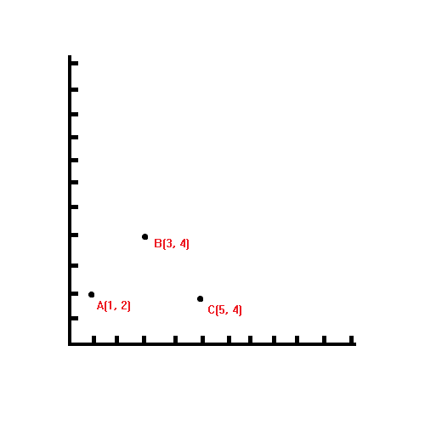
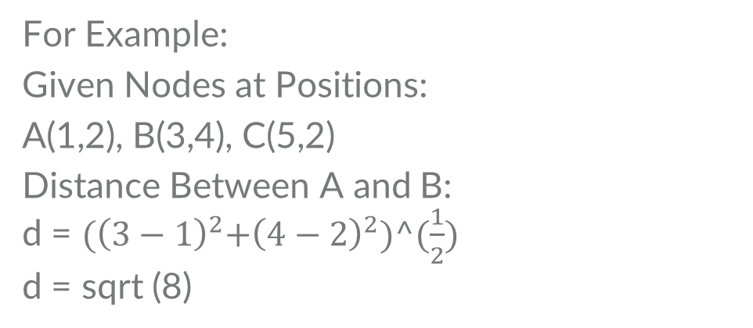
Data Structure Visualization
Applications in Computer Science
Data structures like arrays, trees, and graphs are represented using graphs and coordinates. Analytical geometry helps visualize how data is connected and accessed.
For Example:
Given Nodes at Positions:
A(1,2), B(3,4), C(5,2)
Distance Between A and B:
d = ${(\left(3−1\right)}^{2}+{\left(4−2\right)}^{2})^(\frac{1}{2})$
d = sqrt (8)

Slide 11
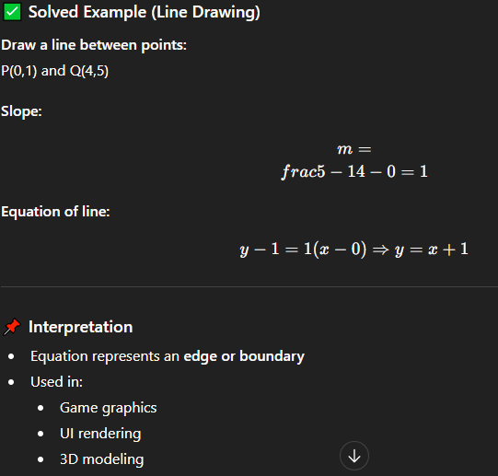
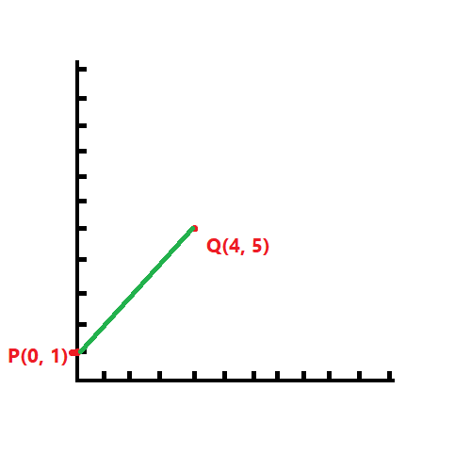
Applications in Computer Science
Computer Graphics
Computer graphics use geometry and functions to draw images on screens. Every shape is plotted using equations and coordinate points.
For Example:
Given Nodes at Positions:
A(1,2), B(3,4), C(5,2)
Distance Between A and B:
d = ${(\left(3−1\right)}^{2}+{\left(4−2\right)}^{2})^(\frac{1}{2})$
d = sqrt (8)

Slide 12

Introduction to Cyber Security
Cyber security focuses on protecting digital systems and data from unauthorized access and attacks. Mathematics plays a critical role in securing information and analyzing network behavior.

Slide 13
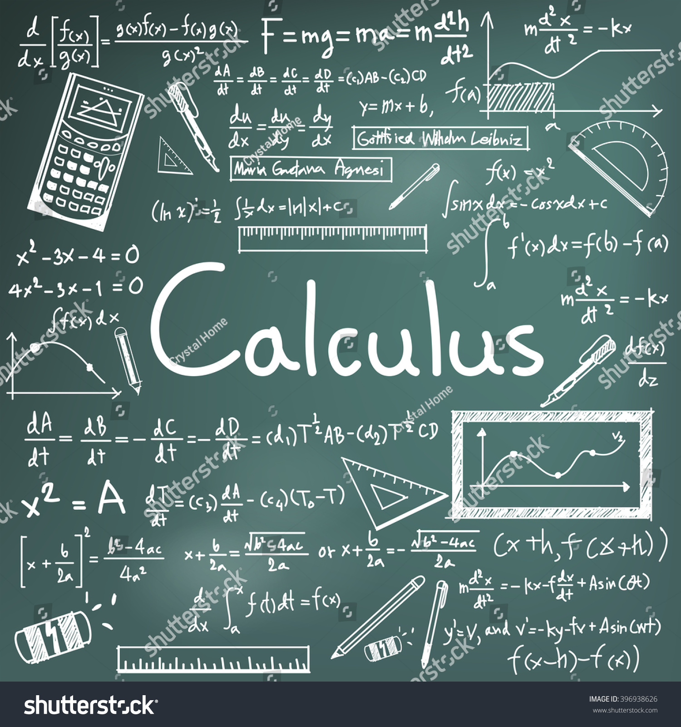

Detecting Unusual Network Traffic Patterns
Roles of Calculus in CyberSecurity
Normal network traffic increases slowly. During attacks like DDoS, traffic increases extremely fast. Calculus uses derivatives to measure how fast traffic changes.
Example:
Given Traffic Function is
P(t) = $4t^{2}$
Its derivative for Rate of Traffic is
P’(t) = 8t
At t = 2, P’(t) = 16 which is normal
At t = 10, P’(t) = 80, this traffic spike is suspicious. A Sudden Spike shows suspicious traffic flow.

Slide 14

Analyzing Attack Behavior
Roles of Calculus in CyberSecurity
Cyber attacks often follow patterns:
Gradual probing
Sudden escalation
Repeated attempts
Calculus helps analyze how attack intensity changes over time.
Attack Attempts:
A(t) = $t^{3}$
Its derivative for rate of Attack Attempts will be
A’(t) = $3t^{2}$
Growth Rate Increases Rapidly -> Attack is escalating
Security Systems respond faster as the rate increases

Slide 15

Computer Graphics
Roles of Calculus in CyberSecurity
Encryption must be:
Secure
Fast
Low on resource usage
Calculus is used to optimize performance by minimizing computation time or energy.
Example:
Encryption Cost:
C(x) = $x^{2}−6x+10$
Its Derivative for Minimum cost of Encryption will be
C’(x) = 2x - 6
For Minimum cost, C’(x) = 0
0 = 2x – 6
x = 3

Slide 16


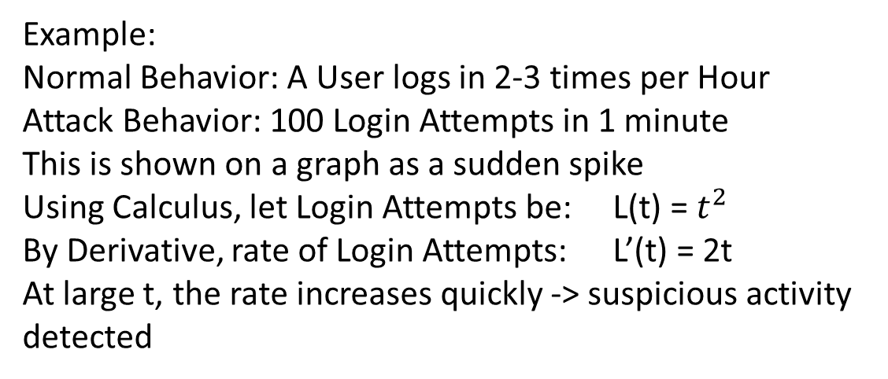
Real Life CyberSecurity Examples
In real-world systems like banking apps, email services, and social media platforms, millions of actions happen every minute. Cyber security systems continuously monitor this activity to protect users.
Normal users log in a few times per day
Hackers may try hundreds of logins per minute
Systems plot login attempts on a graph over time
A sudden spike indicates a brute-force attack
Example:
Normal Behavior: A User logs in 2-3 times per Hour
Attack Behavior: 100 Login Attempts in 1 minute
This is shown on a graph as a sudden spike
Using Calculus, let Login Attempts be: L(t) = $t^{2}$
By Derivative, rate of Login Attempts: L’(t) = 2t
At large t, the rate increases quickly -> suspicious activity detected
1
Login Attempts Monitoring

Slide 17

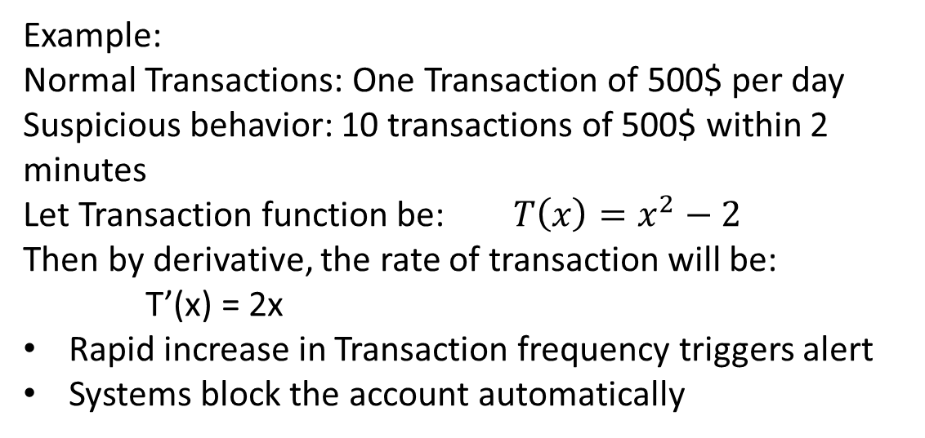
Real Life CyberSecurity Examples
In real-world systems like banking apps, email services, and social media platforms, millions of actions happen every minute. Cyber security systems continuously monitor this activity to protect users.
Transactions usually follow a predictable pattern
Sudden large transfers or rapid repeated transactions are suspicious
Calculus helps analyze the rate of change of transaction amounts
Example:
Normal Transactions: One Transaction of 500$ per day
Suspicious behavior: 10 transactions of 500$ within 2 minutes
Let Transaction function be: $T\left(x\right)=x^{2}−2$
Then by derivative, the rate of transaction will be: T’(x) = 2x
Rapid increase in Transaction frequency triggers alert
Systems block the account automatically
2
Transaction Data Monitoring

Slide 18
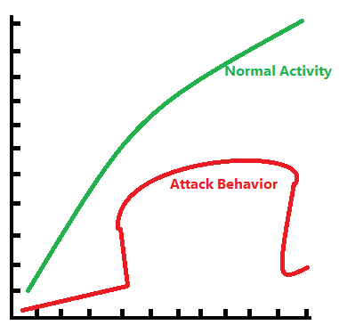
Real Life CyberSecurity Examples
In real-world systems like banking apps, email services, and social media platforms, millions of actions happen every minute. Cyber security systems continuously monitor this activity to protect users.
Graphs show normal vs abnormal behavior clearly
Derivatives detect how fast activity changes
Irregular patterns trigger security alerts automatically
Example:
Normal Activity Forms a smooth curve on a graph.
Attack behavior forms:
Sharp Peaks
Sudden Jumps
These Irregular Patterns are detected using derivatives
3
Detecting Abnormal Behavior

Slide 19
Why These Topics Matter
In Real Life, Calculus and Analytical Geometry play a critical role in every field of life. These are widely used in every field ranging from small fields to large advanced fields.
They teach logical thinking and step-by-step analysis
Help break complex problems into smaller parts
Improve analytical and reasoning abilities
These topics are essential for:
Computer Science
Artificial Intelligence
Data Science
Cyber Security
Robotics and Engineering
Knowledge of these subjects opens doors to careers such as:
Software Engineer
AI / Machine Learning Engineer
Cyber Security Analyst
Data Scientist
1
2
3
Without calculus and geometry, understanding these fields becomes very difficult.
Game and Graphics Developer
Strong Problem Solving Skills
Foundation for Advanced Subjects
Career Opportunities

Slide 20
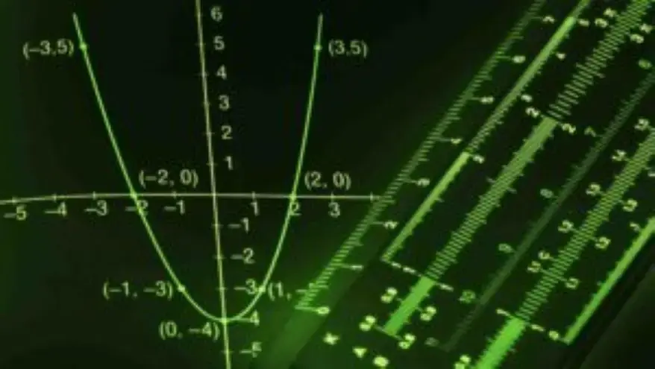
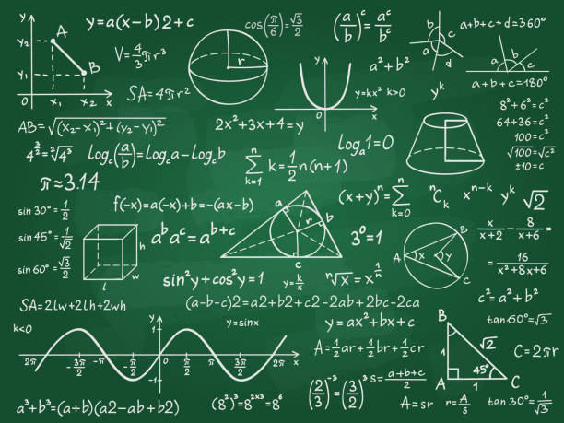
Summary
Calculus
Explains change and motion
Helps with:
Speed and acceleration
Optimization
Predicting future behavior
Example: Sudden increase in network traffic → calculus detects attack
AI model learning → calculus reduces error
Analytical Geometry
Explains shape, space, and position
Helps with:
Coordinates
Graphs
Distance and paths
Example: GPS finds location using coordinates
Cyber security maps attack paths using network graphs

Slide 21
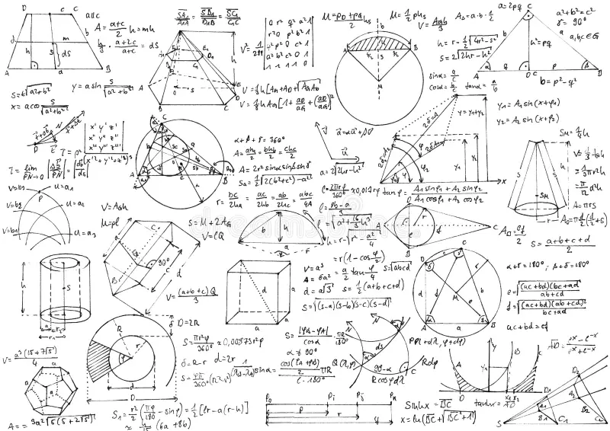
Calculus and Analytical Geometry Together
Calculus and analytical geometry complement each other in real-world systems. Analytical geometry provides a visual and spatial model of the system, while calculus analyzes how activity within that system changes over time. Geometry answers where something is happening, and calculus answers how fast and how abnormal the change is.

Slide 22
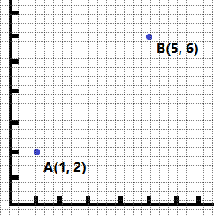
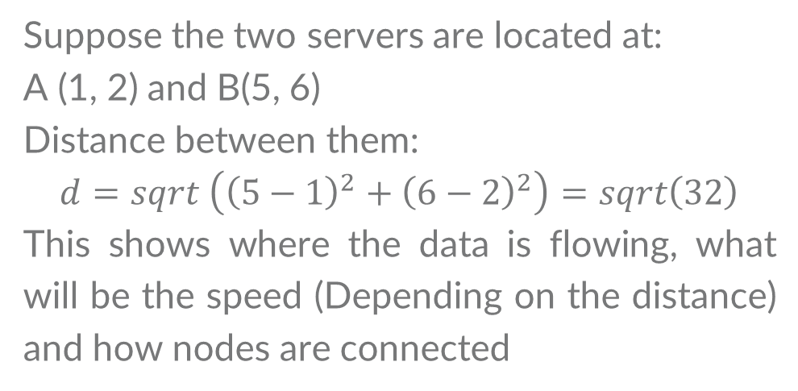
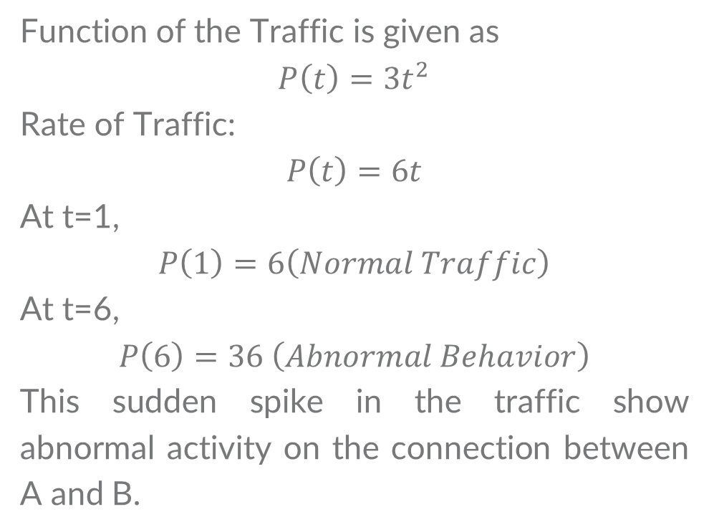
Calculus and Analytical Geometry Together (Example)
Suppose we have a network which have two servers. We will define their mapping through Geometry and the rate of traffic through Calculus
Geomertry (Mapping the Network)
Calculus (Detecting Abnormal Traffic)
Suppose the two servers are located at:
A (1, 2) and B(5, 6)
Distance between them:
$$d=sqrt \left({\left(5−1\right)}^{2}+{\left(6−2\right)}^{2}\right)=sqrt\left(32\right)$$
This shows where the data is flowing, what will be the speed (Depending on the distance) and how nodes are connected
Function of the Traffic is given as
$$P\left(t\right)=3t^{2}$$
Rate of Traffic:
$$P\left(t\right)=6t$$
At t=1,
$$P\left(1\right)=6\left(Normal Traffic\right)$$
At t=6,
$$P\left(6\right)=36 \left(Abnormal Behavior\right)$$
This sudden spike in the traffic show abnormal activity on the connection between A and B.

Slide 23
References
Stewart, J. Calculus: Early Transcendentals
Thomas, G. Calculus
Anton, H. Elementary Linear Algebra
Khan Academy (Calculus & Analytical Geometry)
NIST Cyber Security Resources

Slide 24
THANK YOU!
For your attention
BSCYS-F24B | Air University

